Slide 1
PERIODONTAL LIGAMENT
GUIDED BY: PRESENTED BY:
DR.P.SURESH DR.K.LATHA
PROFESSOR & HOD 1ST PG STUDENT
DEPT OF PERIODONTICS DEPT OF PERIODONTICS

Slide 2
CONTENTS:
INTRODUCTION
DEFINITIONS
DEVELOPMENT OF PDL
DEVELOPMENT OF SHARPEYS FIBERS
FIBER GROWTH FROM SHARPEYS FIBER TO CONTINUOUS PDL
PRINCIPLE FIBER FORMATION
SHAPE & SIZE OF PDL
STRUCTURE OF PDL
CELLULAR ELEMENTS
EXTRACELLULAR ELEMENTS

Slide 3
OTHER STRUCTURES IN THE CONNECTIVE TISSUE
FUNCTIONS OF PDL
PERIODONTAL LIGAMENT HOMEOSTASIS
AGE CHANGES IN PDL
CLINICAL CONSIDERATIONS
CONCLUSION
REFERENCES

Slide 4
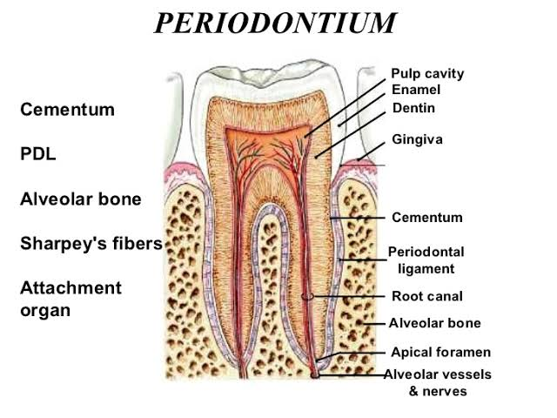
INTRODUCTION:
Periodontium

Slide 5
DEFINITIONS:
The periodontal ligament is composed complex vascular & highly cellular connective tissue that surrounds the tooth root & connects it to the inner wall of the alveolar bone.
- CARRANZA
The connective tissue that surrounds & attaches root of teeth to the alveolar bone.
- GPT

Slide 6
The periodontal ligament occupies the periodontal space, which is located between the cementum & the periodontal surface of the alveolar bone & extends coronally to the most apical part of the lamina propria of the gingiva.
- ORBAN
The periodontal ligament is the soft, richly vascular & cellular connective tissue which surrounds the root of the teeth & joins the root cementum with the socket wall.
- LINDHE.

Slide 7
DEVELOPMENT OF PDL:
Begins – root formation.
HERS formation.
Dental follicle cells - Two cell populations
Mesenchymal cells of dental follicle proper
Peri-follicular cells
Peri-follicular cells- widely spaced
As root formation continues- perifollicular cells gain polarity
Undifferentiated mesenchymal cells.

Slide 8
Formation of sharpeys fibers:
First step
Tooth side first
AEFC
Fiber fringe
mineralization

Slide 9
On bone side – different way
Extensive remodelling, embedded & mineralise
Osteoid from osteoblasts
At resorption sites
At areas of fibers escape mineralization
Fibers vary in size

Slide 10
FIBER GROWTH:
During sharpeys fiber formation: central part of pdl is made of loosely arranged collagenous mass, precursor cells, etc.
Fibroblasts – new extracellular matrix & remodel.
Apposition of fibers
Cross linked & continuous pdl.

Slide 11
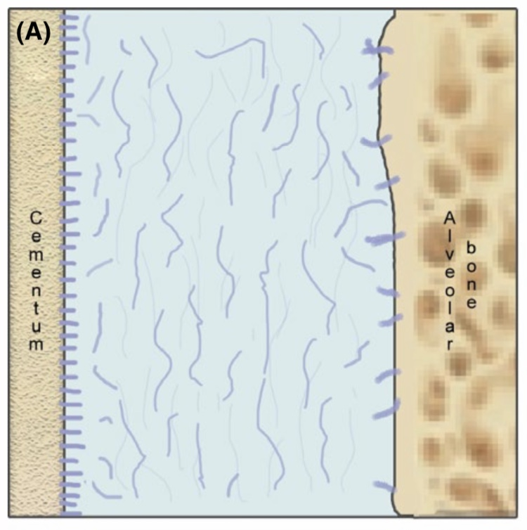
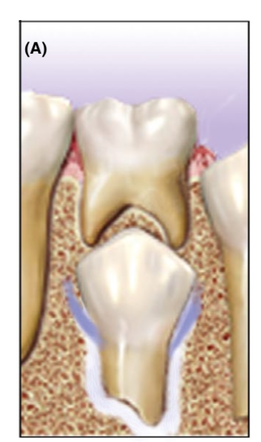
Principle fiber formation & their orientation at different stages of odontogenesis:
Pre – emergence stage:

Slide 12
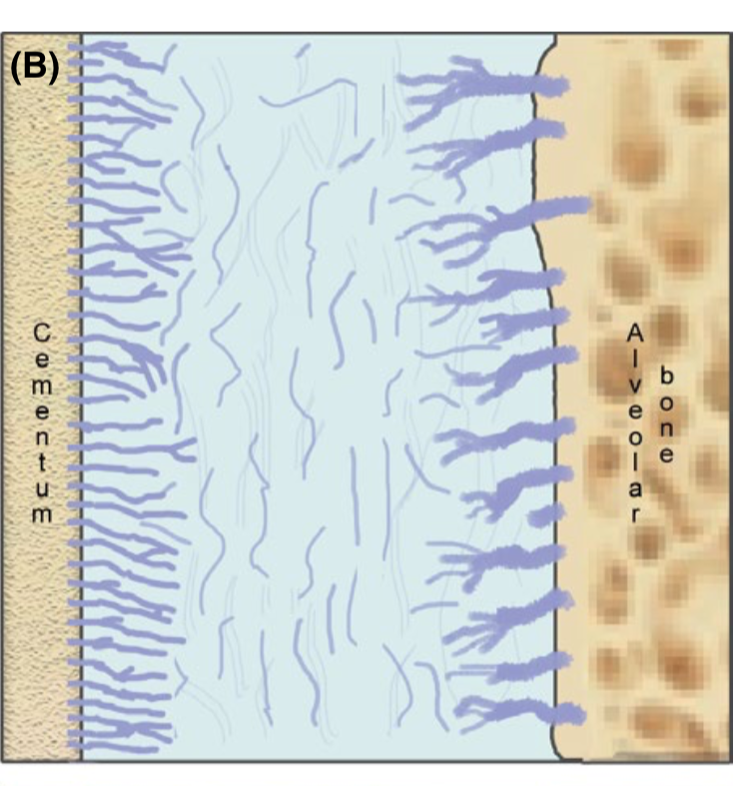
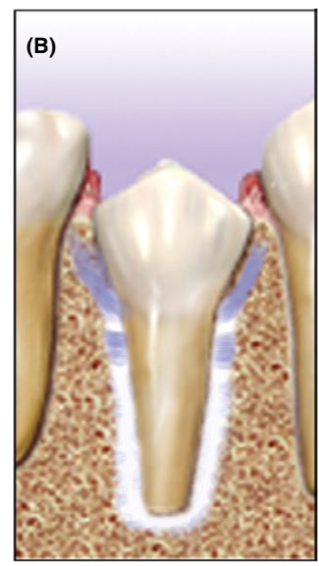
Pre – occlusal stage:

Slide 13
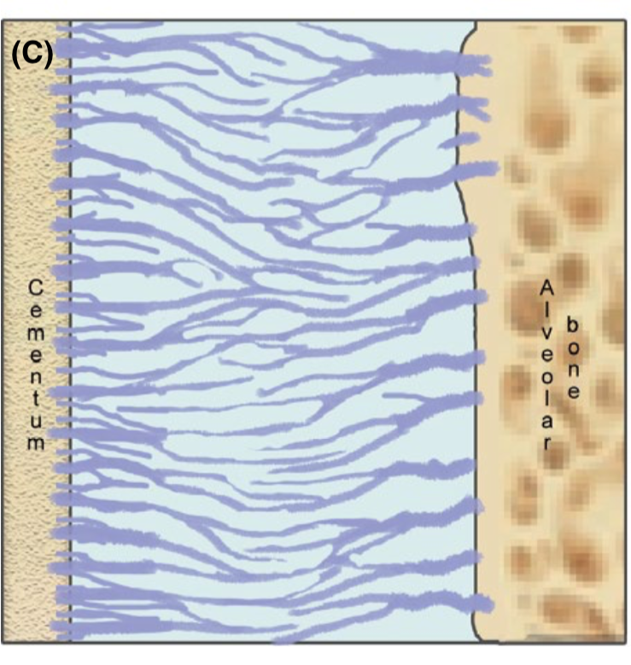
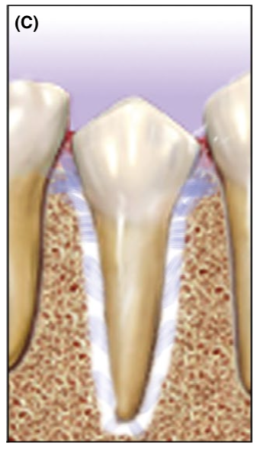
First occlusal contact:

Slide 14
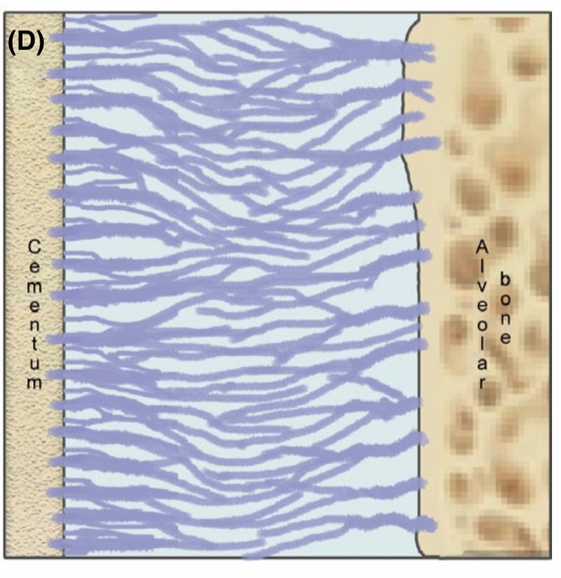
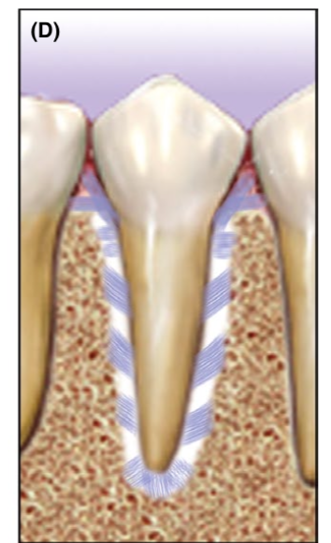
Full occlusal contact:

Slide 15
Size & shape of pdl:
Width ranges between – 0.15 to 0.38 mm.
Thinnest – middle 3rd of the root ( hour glass appearance)
Thickness in young adults – 0.21 mm
mature adults – 0.18 mm
older adults – 0.15 mm

Slide 16
Periodontal space on radiograph – 0.4 to 1.5 mm.
Periodontal space of permanent teeth < deciduous teeth.
Thickness at time of eruption – 0.1 – 0.5 mm
function – 0.2 – 0.35 mm
hypo function – 0.1 – 0.15 mm

Slide 17
Structure of pdl :
Cellular elements:
Synthetic cells
Defence cells
Extracellular elements:
Fibers
Resorptive cells
Progenitor cells
Epithelial cell rests of malassez
Ground substances

Slide 18
Synthetic cells:
Osteoblasts:
Bone forming cells, lines tooth socket
Cuboidal
RER, mitochondria & vesicles are abundant in active cells
Desmosomes & tight junctions.

Slide 19
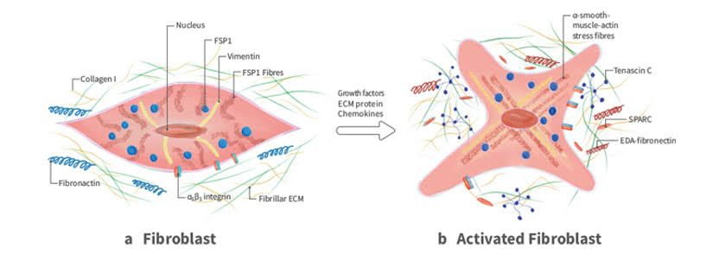
Fibroblasts :
Predominant cell type
Origin – partly from dental papilla & follicle
Fusiform, abundant organelles for protein synthesis & secretion
Produce growth factors & cytokines like IGF–1, BMPs, PDGF, IL-1.

Slide 20
CEMENTOBLASTS:
Line the surface of cementum, irregular arrangement.
Almost cuboidal, abundant cytoplasm & organelles.
Cells secreting cementum – basophilic cytoplasm.
Gap junctions & desmosomes.

Slide 21
Resorptive cells:
Osteoclasts:
Cells that resorb the bone
Large multinucleated or small mononuclear cells
Multinucleated cells are formed by fusion
Howship’s lacunae
Numerous mitochondria, lysosomes, abundant golgi saccules, free ribosome's, but little RER
Ruffled borders
Clear zone

Slide 22
FIBROBLASTS:
Phagocytose & show rapid degeneration of collagen, resulting in fast turn over of collagen.
Early studies – collagen degradation is by extra-cellularly by collagenase.
Later – due presence of cellular organelles
intracellularly

Slide 23
Acc to some studies, collagen is degraded intra-cellularly in healthy tissues.
Hence, the degradation is both intra & extracellular.

Slide 24
Intracellular degradation:
In vitro studies, showed fibroblasts have the capability of phagocytosing collagen fibrils from extracellular environment & cause the collagen degradation.
Cell surface alkaline phosphatase & MMPs may be involved in internalizing collagen fibrils.
Lysosomal cysteine proteinase of lysosomal granules are capable of rapid degradation of collagen fibrils.

Slide 25
phagocytosis of collagen fibrils by fibroblasts
Banded fibril surrounded by an electron lucent zone
Banded fibrils surrounded by an electron dense zone
Phagosome fuses with primary lysosome to form phagolysome
Indistinct banding, electron dense zone
Enzymatic degeneration of fibrils, until fibrils loose their characteristic structure

Slide 26
Extracellular degradation:
Involves collagenases (MMP-1), it is thought to cleave the triple helical portion
Along with MMP-4, it leads to denaturation of collagen under physiological conditions
Rest undergo proteolysis by MMP-2 (gelatinase) & MMP-5
Glycoproteins (fibronectin), proteoglycan on fibril surface, which mask the collagen binding site must be remove by stromelysin (MMP-3), before the action of collagenase.

Slide 27
CEMENTOCLASTS:
They resemble osteoclasts
Occasionally seen in normal pdl, as cementum doesn’t undergo remodelling continuously, but is deposited continuously throughout the life.
Resorption occurs under certain conditions

Slide 28
Progenitor cells:
All connective tissues, including pdl contain progenitor cells.
It is evident that progenitor cells are present, that show burst of mitosis upon application of pressure in orthodontic therapy & after wounding , which stimulate proliferation & differentiation, forming cells of pdl.
Adjacent to blood vessels.

Slide 29
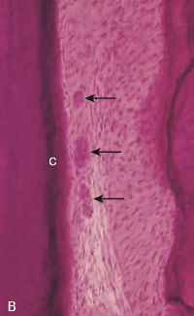
Epithelial cell rests of malassez:
They were first described by Malassez in 1884.
Pdl contains epithelial cells close to cementum.
They appear as strands, islands or tube-like structures parallel to root surface & about 25μ from cemental surface.
Distribution varies with age & site.

Slide 30
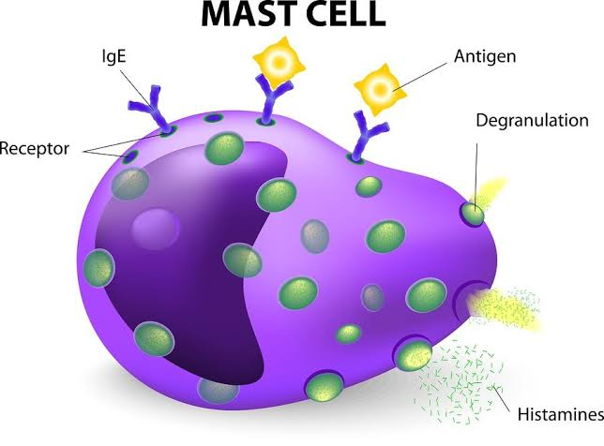
Defence cells:
MAST CELLS:
Round or ovoid with D=12 to 15μm, associated with blood vessels.
Numerous granules & small, round nucleus.
It degranulates in response to antigen-antibody reaction on the surface.
They contain heparin, histamine & in some animals seratonin.
Histamine plays role in inflammatory conditions.

Slide 31
Occasionally seen in normal pdl.
Histamine causes, proliferation of endothelial & mesenchymal cells & thus play a role in regulating their populations.

Slide 32
MACROPHAGES:
Present in pdl & located adjacent to blood vessels.
Derived from monocytes, & phagocytose particulate matter & micro-organisms.
Dual role: 1.phagocytosing dead cells
2.secreting growth factors

Slide 33
EOSINOPHILS:
Occasional
Phagocytosis
Granules are seen

Slide 34
EXTRA-CELLULAR SUBSTANCES
GROUND SUBSTANCE
FIBERS

Slide 35
GROUND SUBSTANCES
70% - water
Significant effect on the tooth’s ability to withstand stress load.
Gel – like matrix.
Functions: ion & water binding & exchange,
control of collagen fibrillogenesis &
fiber orientation &
binding of growth factors.

Slide 36
Ground substance is secreted by fibroblasts.
It consists of mainly : glycosaminoglycans
proteoglycans &
glycoproteins.

Slide 37
Glycosaminoglycans:
Main types are hyaluronan, dermatin, chondroitin & heparin sulphates.
Hyaluronan – large volume
Located near the surface of collagen fibrils.

Slide 38
Proteoglycans:
These are compounds containing glycosaminoglycans attached to a protein core
Two main:
Proteoglycans containing chondroitin sulphate &
Dermatan sulphate hybrids

Slide 39
Glycoprotein:
Predominant type is fibronectin
it promotes attachment of cells to collagen, also involved in cell migration & orientation.
Others like tenascin & vitronectin.
Tenascin – adjacent to alveolar bone & cementum. It acts to transfer the forces of mastication & stresses.
Vitronectin found adjacent to elastic fibers.

Slide 40
Fibers:
Principle fibers are important components of pdl.
Sharpey’s fibers.
Connective tissue fibers are mainly collagenous
Small amounts of oxytalin & reticular fibers.

Slide 41
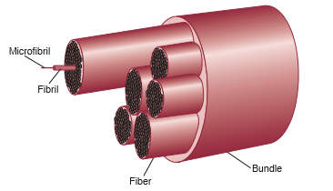
Collagen:
Collagen is a protein with different amino acids.
Glycine, proline, hydroxylysine & hydroxyproline.
Amount of collagen in tissue hydroxyproline
Functions :
Maintenance of framework
Tone of the tissue

Slide 42
Wide range of diversity.
At least 28 types are present.
Collagen synthesis occurs inside fibroblasts.
tropocollagen
microfibrils
fibrils

Slide 43
Collagen fibrils – transverse striations (64 nm).
Main type of collagen in pdl – Type 1 & 3 ( >70 % - type 1)
Small amounts – type 5 & 6
Traces – 4 & 7 are found.

Slide 44
Principle fibers:
TRANSSEPTAL GROUP:
Interproximally, over alveolar crest to adjacent teeth cementum .
Reconstructed even after destruction of alveolar bone.

Slide 45
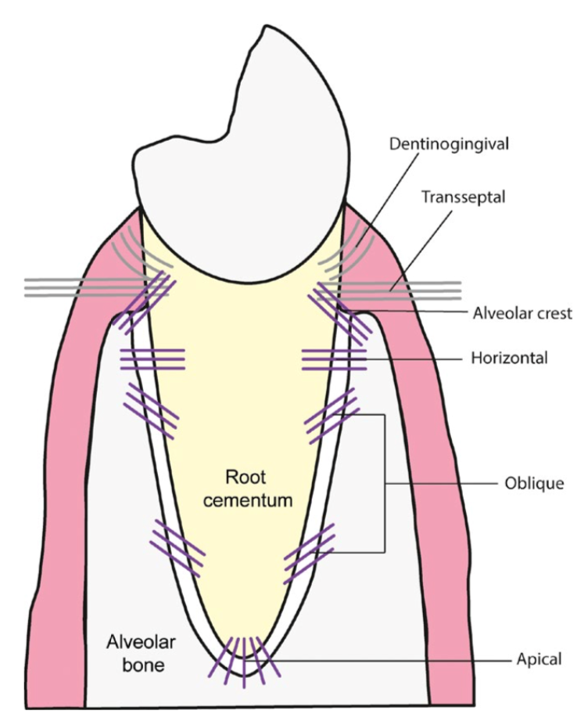

Slide 46
ALVEOLAR CREST GROUP:
Obliquely, from cementum beneath the JE to the alveolar crest.
Resist – tilting, intrusion, extrusion & rotational forces.
Incision – does not cause mobility.

Slide 47
HORIZONTAL GROUP:
Run at right angles to the long axis of the tooth cementum to the alveolar bone.
Resist – horizontal & tipping forces.

Slide 48
OBLIQUE GROUP:
Most numerous
Inserted into alveolar bone at a coronal position than their cementum attachment – obliquely.
Resist – vertical & intrusive forces.

Slide 49
APICAL GROUP:
From cementum at root tip to fundus of bony socket.
Resist – luxation, tooth tipping,
protect blood & lymphatic vessel, nerves at root apex.
Not seen in an incompletely formed roots.

Slide 50
INTERRADICULAR GROUP:
Inserted into cementum from crest of interradicular septum in multirooted teeth.
Resist – tipping, torquing & luxation.

Slide 51
Elastic fibers:
PDL does not contain mature elastic fibers, two immature forms are found:
Oxytalin
Elaunin

Slide 52
Oxytalin fibers :
Run parallel to root surface & bend to attach to the cementum at cervical 3rd of the root.
They are thought to regulate the vascular flow.

Slide 53
Other structures:
Blood vessels:
Pdl show abundant vascular supply, may be due higher or elevated metabolic requirments.
Arterial supply:
Inferior & superior alveolar arteries to mandible & maxilla respectively.

Slide 54
Rich vascular plexus at apex & in cervical part of pdl
Blood supply increases from incisors to molars.
Venous drainage:
Veins accompany their arterial counterparts.
Receive blood from capillaries & glomera
Dense network – apex.

Slide 55
Lymphatic drainage:
Lymph from periodontal tissues drain into lymph nodes of head & neck.
Sub-mental – labial & lingual gingiva of mandibular incisors.
Sub-mandibular – lingual gingiva of mandibular premolar & molar region, buccal gingiva of maxilla.
Jugulo-digastric – third molars drain directly.
Deep cervical – maxillary palatine gingiva.

Slide 56
Nerves:
Functionally two types : sensory & autonomic .
Sensory fibers – nociception & mechanoception with pain, pressure, touch & proprioceptive sensation.
Autonomic fibers are associated with vessels.

Slide 57
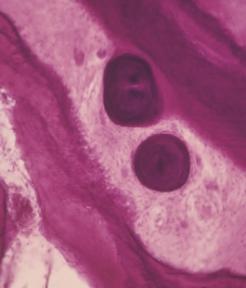
Cementicles:
Calcified bodies seen in the pdl.
Free or bound forms.

Slide 58
Functions of pdl:
Physical functions:
Soft tissue casing to protect vessels & nerves.
Transmission of occlusal forces to the bone.
Attachment of the teeth to the bone.
Maintenance of gingival tissue.
Resistance to impact of occlusal forces.

Slide 59
Resistance to impact of occlusal forces ( shock absorption)
Three theories are used to explain:
Tensional theory
Viscoelastic theory
Thixotrophic gel theory

Slide 60
Tension theory:
Acc to this, principle fibers are major factors in supporting the teeth & transmitting forces to the bone.
Upon force application fibers unfold & straighten
transmit force to alveolar bone
elastic deformation of bony socket

Slide 61
Visco-elastic system theory:
Forces on tooth
Extracellular fluid of pdl into marrow spaces
The fiber bundles absorb slack & tighten
Blood vessel stenosis
Arterial Back pressure cause ballooning of the vessels
Passage of Blood ultra-filtrates into the tissues
Replenishing the tissue fluid

Slide 62
Thixotrophic theory:
Pdl has behaviour of thixotropic gel
Property of becoming fluid when shaken or stirred & then becomes semisolid again
Force application leads to : gel to fluid form.
Removal of force causes : fluid to gel.

Slide 63
Transmission of occlusal forces to bone:
Principle fibers – suspension bridge or hammock.
Axial forces tendency to displace root into bone.
Oblique fibers alter major part of axial forces.
horizontal or tipping forces two phases of tooth movements.
1st within confines of pdl
2nd displacement of facial & lingual bony plates.

Slide 64
Formative & Remodelling:
Cells of pdl formation & resorption of cementum & bone.
Pdl constantly undergo remodelling, old cells & fibers are replaced by new once.
Resident mesenchymal cells develop into osteoblasts & cementoblasts.

Slide 65
Nutritional function:
Pdl supplies nutrients to the cementum, bone & gingiva by blood vessels & also provides lymphatics.
Its highly vascular, it provides hydrodynamic damping to applied forces.

Slide 66
Sensory function:
Pdl shows abundant nerve supply for transmitting tactile, pressure & pain.
Nerve bundles pass into pdl through apical foramen & divides into single un-myelinated fibers that loose the mylein sheet & ultimately end as follows:
Free endings, tree like configuration & carry pain.
Ruffini – like mechano-receptors, located in apical area
Coiled meissner’s corpuscles – mechano-receptors in mid-root region
Spindle like pressure & vibration endings, located at apex.

Slide 67
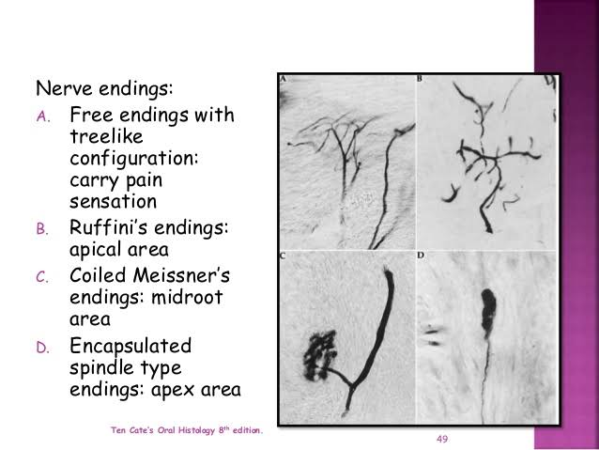

Slide 68
Periodontal ligament homeostasis:
Pdl has capacity to maintain its width more or less overtime.
Studies suggest that cell with in the pdl, both during development & regeneration, secrete molecules that regulate extent of mineralization & prevent ankylosis.
Molecules that play role in maintaining un-mineralized pdl is : Msx2, Matrix Gla protein, TGF-β, Prostaglandins, balance between bone sialoprotein & osteopontin activity.

Slide 69
AGE CHANGES IN PDL:
With age decreased number of fibroblasts, decreased organic matrix production, increased amount of elastic fibers, etc.
Functional status of the tooth determines the width of the pdl, width of space is decreased if tooth is unopposed (hypo function) or will increase with excessive occlusal loading.

Slide 70
In investigation of role of pdl in maintaining periodontal health & pathogenesis of periodontitis, one approach is to examine the mediators of bone homeostasis such as RANKL & osteoprotegerin.

Slide 71
Clinical considerations:
Restorative dentistry
Acute trauma
Orthodontic tooth movement

Slide 72
Conclusion:
Commonest pathology related to pdl is inflammatory periodontal disease.
Better understanding of cell & molecular biology of the developing & regenerating periodontium offers new avenue.

Slide 73
References
Carranza’s clinical periodontology – 11th edition.
Jan Lindhe, Niklaus P. Lang – 6th edition; clinical periodontology and implant dentistry.
Orban’s oral histology and embryology – 13th edition.

Slide 74
Dr. Dean. R, The Periodontal Ligament: Development, Anatomy and Function : OHMD- Vol. 16- No.6- December,2017.
Jong T. De, Bakker A.D, Everts. V, Smit.T.H: Review Article: The intricate anatomy of the periodontal ligament and its development: J Periodont Res. 2017;1-10.

